Slide 1



Week 4, Lecture 7
Introduction to Flask

Slide 2
Admin stuff and reminders:
Don’t forget this week’s discussion topics!
https://login.codingdojo.com/d/309/122/1196
https://login.codingdojo.com/d/309/122/1197
Due Sunday night at 11:59 PM Pacific! Don’t fall behind!!
This week’s core assignments - there are four of them:
Checkerboard
HTML Table
Counter
Dojo Survey
Don’t fall behind on core assignments this week!
Recommended optional assignment: Ninja Gold
Remember the 20-minute rule!!
Feel free to collaborate with one another! You may use the lecture room!
If you opted into Career Services - get in touch with your Career Services Manager (CSM) as soon as you can, especially if you’re only taking one stack!

Slide 3
Academic honesty
Please do NOT use the exact solution code and submit that as your assignment. This is Academic Misconduct, and could mean immediate Academic Probation and possibly additional punitive measures.
The solution code is meant as a guide so you can see how one might go about solving the problem. There are many ways to figure a problem out in most cases.
You should ALWAYS type your own code. That means your own function/method names, your own variable names, etc.
It is still 100% okay to collaborate with others! But again, type your own code.
Write comments in your code! Explain in your own words what the code is doing. (You don’t necessarily need to comment on every line, but at least each important section.)
Many of you are experiencing a time crunch due to jobs, family, health, etc. That’s fine! I’d rather that you submit what you have, and then talk to a TA/instructor to fill in the remaining gaps. That’s what code reviews are for! (https://calendly.com/instructor-adrian-b and https://calendly.com/onl-python-flask)
Don’t forget you may email me as well!

Slide 4
How was MySQL last week?
1 = Not good
10 = Very good

Slide 5
How are you feeling today?
1 = Not good
10 = Very good

Slide 6
Week 4, Lecture 7 agenda:
Review of HTTP request/response cycle
What is Flask?
Virtual environments
Routing
Rendering HTML files and the Jinja templating engine
Path variables
Forms (if time permits, otherwise we’ll save it for the next lecture)
Addendum for Mac users with localhost:5000 issues

Slide 7
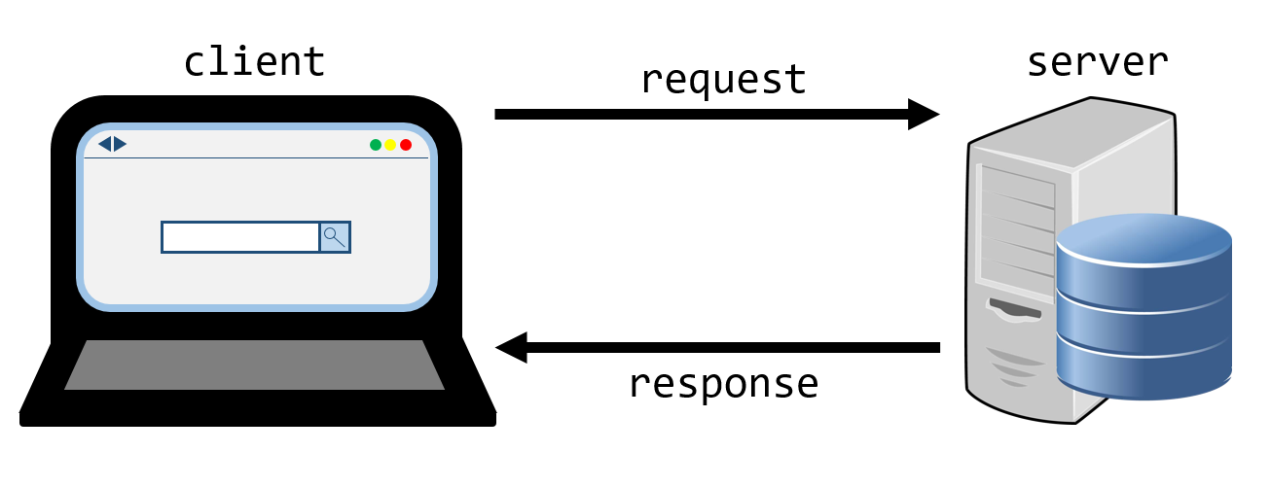
HTTP request/response cycle
Refresher: https://login.codingdojo.com/m/283/8966/60776 (in Web Fundamentals -> HTML -> HTML -> How the Web Works)

Slide 8
What is Flask?
A lot of you have heard of flasks that are used in chemistry and other places. They hold water and other liquids.
Here, Flask is a lightweight web framework that was actually originally developed as an April Fool’s joke! Today it is one of the most popular web frameworks out there.
Many websites have been built using Flask - including LinkedIn!
With Flask, you can really customize your website quite a lot! This means you will likely have to install some packages (more on that later).
Flask is one of the most popular web frameworks for Python developers!

Slide 9
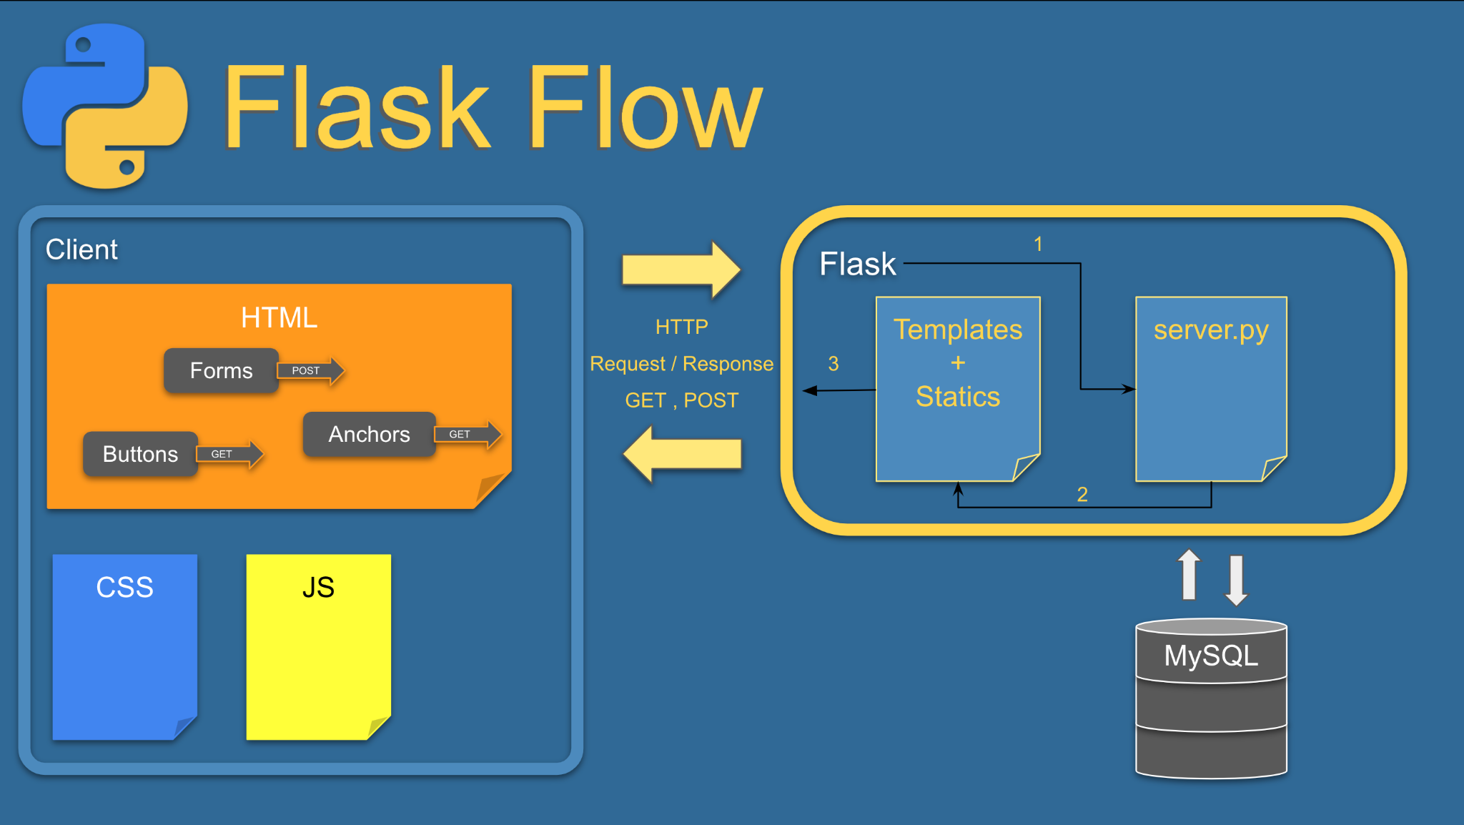
What is Flask?
From Flask Fundamentals -> Overview (https://login.codingdojo.com/m/309/9266/62478):

Slide 10
Virtual environments
What are they, and why would we need them?
A virtual environment is used for each of your projects. Each project will have its own set of packages used. Some projects will have *different* versions of packages, like maybe one version of Flask for one project and another version for a different one.
Not all projects will have the exact same packages used.
For our projects, we will use pipenv to install packages. (Make sure you’ve already installed it first!)

Slide 11
Virtual environments
Creating one for the first time:
pipenv install <package_names_go_here>
Example: pipenv install flask pymysql (spaces between package names)
Starting/restarting one: pipenv shell
Exiting an environment: exit
Adding packages to an existing environment: Start the environment first, then type:
pipenv install <package_name>
Example: pipenv install pymysql
NOTE: some of you might need python -m or python3 -m before each command, so python -m pipenv install flask==2.0.3, for example.

Slide 12
Virtual environments
Deleting a virtual environment: Delete the pipfile and pipfile.lock files
If you still experience errors after deleting them: try “pipenv --rm” (notice the double dashes)
Don’t have nested environments! In other words, don’t have a folder with a project, then a child folder have a separate project.
Do not create an environment while one is active! Usually the name of the virtual environment will be shown in the terminal.

Slide 13
Routing
Why would we want routes?
Nearly all websites have tons of pages. Each of these pages have their own routes.
For example, Wikipedia has one route that shows the home page, while there’s another route that will show an article, then another route with another article, a route for editing a page, etc.
Your server will have these routes defined so that it can direct traffic accordingly, just like an air traffic controller.

Slide 14
Question 1
Create a route called “hello” that returns an HTML file called “hello_world.html”. (You may name the function anything you want, but the route must be called “hello”. Don’t worry about importing for this question.)

Slide 15
Question 1
Create a route called “hello” that returns an HTML file called “hello_world.html”.
Answer:
@app.route("/hello") # Route name goes here
def hi_page(): # Function can be called anything - do NOT reuse names!
return render_template("hello_world.html")
Don’t forget to import as needed! from flask import Flask, render_template # added render_template!
app = Flask(__name__)

Slide 16
Routing and Flask demo

Slide 17
Routing
All your routes will normally do one of two things:
Return an HTML file
Redirect to another route (more on this in the next lecture)
Both of these return responses!
(Routes can also return HTML response objects, and this is useful for JSON data. This is covered in the AJAX section.)

Slide 18
Routing
Here is how you define your route:
from flask import Flask, render_template # Import these!
app = Flask(__name__)
# Route name goes here - more logic involving request types will be
# added in the next lecture
@app.route("/route_name")
def function_name(): # Function name can be anything
# Additional logic goes here, such as pulling data from a database
return render_template("your_html_file.html")

Slide 19
Routing
ALWAYS start your route name with a forward slash “/”! Do NOT end a route with a forward slash, as “/hello” is a different route from “/hello/”.
To view the route in the browser, type “localhost:5000/hello” for the “/hello” route. The “/” route can be accessed by typing “localhost:5000” without the “/”.
Do NOT duplicate route OR function names!!
You may define as many routes as you need.

Slide 20
Question 2
Take a look at this route and HTML file:
@app.route("/numbers")
def number_function(): # Function name can be anything
number = 42
# Additional logic goes here, such as pulling data from a database
return render_template("numbers.html") # Change this line
The numbers.html file (only the body):
<body>
<p>My favorite number is ???.</p> <!-- Change this line –->
</body>
Change the render_template function to give the HTML file the number. You can name the variable you pass in anything you wish.
Replace the ??? in the HTML file with the value from that variable. (Your answer cannot be “42” - it has to include {{ }}.)

Slide 21
Question 2
Answers:
@app.route("/numbers")
def number_function(): # Function name can be anything
number = 42
# Additional logic goes here, such as pulling data from a database
return render_template("numbers.html", my_number = number)
The numbers.html file (only the body):
<body>
<p>My favorite number is {{ my_number }}.</p>
</body>
Notice how the variable name in orange must match exactly.
There is no limit to how many variables you can give an HTML file.

Slide 22
HTML/Jinja demo

Slide 23
HTML files and Jinja
In the HTML file:
To display a value: {{ var_name }}
REMEMBER to match the variable name with what you pass to the HTML file in the render_template function!
Loops and if statements are similar in syntax:
{% for val_or_key in list_or_dictionary %}
{{ val_or_key }}
{% endfor %}
{% if condition %}
{% elif %}
{% else %}
{% endif %}

Slide 24
HTML files and Jinja
Comments are a bit different in Jinja: you use the following format to comment in the HTML:
{# comment goes here #}
NOTE: Using <!-- and --> to comment in the HTML file will NOT work for Jinja template tags like {% %} and {{ }}. Use {# #} instead.
More documentation can be found here: https://jinja.palletsprojects.com/en/3.0.x/

Slide 25
Question 3
Here is the same route and HTML from Question 2 with slight tweaks:
@app.route("/numbers") # Add something here
def number_function(): # Add something here
return render_template("numbers.html", this_number = ???) # Replace the ???
The numbers.html file:
<body>
<p>My favorite number is {{ this_number }}.</p>
</body>
Add a path variable called number in your route and change the code in the route to pass that number to the HTML file. (There are a couple of ways to do this, but you only need to figure out one way for this exercise.)

Slide 26
Question 3
Answers:
Version 1:
@app.route("/numbers/<number>") # Path variable added here inside the < >
def number_function(number): # MUST pass in all path variables as parameters!
converted_number = int(number) # By default, path variables are strings!
return render_template("numbers.html", this_number = converted_number)
Version 2 with type casting in the path variable:
@app.route("/numbers/<int:number>") # Specified data type here with int
def number_function(number): # MUST pass in all path variables as parameters!
# Notice that the path variable can be passed in directly in this case
return render_template("numbers.html", this_number = number)

Slide 27
Path variables demo

Slide 28
Path variables
In your routes, you can use path variables! You’ll use them a lot with your projects, as they will often hold the id of an item, such as the id of a user, book, dojo, carrier, car, etc.
Path variables are defined inside the < > like so:
@app.route("/books/<id>")
You can cast a path variable to be a specific data type. The most common one is int. For example:
@app.route("/books/<int:id>")
You MUST pass in path variables as parameters when defining your functions:
@app.route("/books/<int:id>")
def show_book(id):
More information can be found here in the Flask documentation (take a look!): https://flask.palletsprojects.com/en/2.0.x/

Slide 29
localhost:5000 and Mac users
Recently Mac has turned on a feature called “AirPlay Receiver” that uses port 5000. To disable it, follow this page: https://stackoverflow.com/questions/69818376/localhost5000-unavailable-in-macos-v12-monterey
Alternatively, if you want to change the local host number from 5000, you may by doing this:
if __name__=="__main__":
app.run(debug=True, port=5001) # Note the port number!
That means you can run your project on localhost:5001 instead of localhost:5000. It’s recommended that you pick a number not divisible by 100, so don’t use 5000, 5100, 5200, etc.

Slide 30
Bonus/group exercises

Slide 31
Python review problems
Write a function that takes in a list of numbers as input and return its sum. Try not to use the range() function if you can.
Write a function that accepts a dictionary and prints each key value pair in this format: “Key: value”. For example, if you had:
x = {
"name": "Adrian",
"number": 15,
}
Then you should print:
name: Adrian
number: 15

Slide 32
Python review problems
Answers will vary as there will likely be more than one correct way:
1.
def sum_list(my_list):
sum = 0
for val in my_list:
sum += val
return sum
2.
def print_dictionary(my_dictionary):
# This is one version - there are other correct ways to do this, like .items()
for key in my_dictionary:
print(f"{key}: {my_dictionary[key]}")

Slide 33
Routing practice
In a new Flask project, define these routes:
/hello - Returns an HTML file that shows “Hello world!” 5 times
/hello/10 - Returns a new HTML file but shows “Hello world!” 10 times
/hello/30 - Shows “Hello world!” 30 times
(BONUS: use the same HTML file for ALL /hello routes, regardless of number.)
/welcome - Returns a different HTML file that shows “Welcome user!”
/welcome/jose - Returns a new HTML file, but shows “Welcome Jose!”
/welcome/angela - Shows “Welcome Angela!”
(BONUS: Use only one HTML file for ALL welcome routes, regardless of name.)
If you do this right, you only will need 4 routes in your file - NOT six. (HINT: Use path variables!)

Slide 34
Routing practice
In your server.py file (answers may vary a bit):
@app.route("/hello")
def hello_route():
return render_template("hello.html")
@app.route("/hello/<int:count>") # Notice the path variable!
def hello_route_count(count):
return render_template("hello.html", my_count = count)
@app.route("/welcome")
def welcome_route():
return render_template("welcome_page.html")
@app.route("/welcome/<name>") # Notice the path variable!
def welcome_route_with_name(name):
capitalized_name = name.capitalize()
return render_template("welcome_page.html", my_name = capitalized_name)

Slide 35
Routing practice
hello.html (body only)
<body>
{% if my_count %} {# Check to see if my_count was passed in or not #}
{% for k in range(my_count) %}
<p>Hello world!</p>
{% endfor %}
{% else %}
{% for k in range(5) %}
<p>Hello world!</p>
{% endfor %}
{% endif %}
</body>
welcome_page.html (body only):
<body>
{% if my_name %}
<p>Welcome {{ my_name }}!</p>
{% else %}
<p>Welcome user!</p>
{% endif %}
</body>

